Slide 1



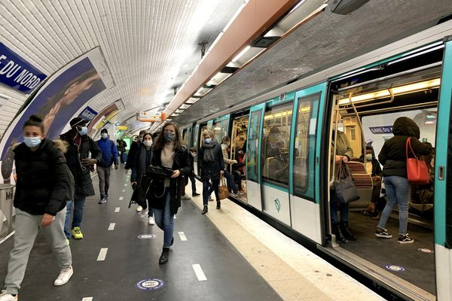
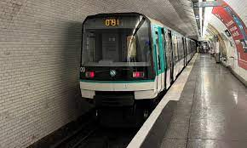

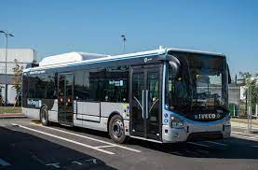
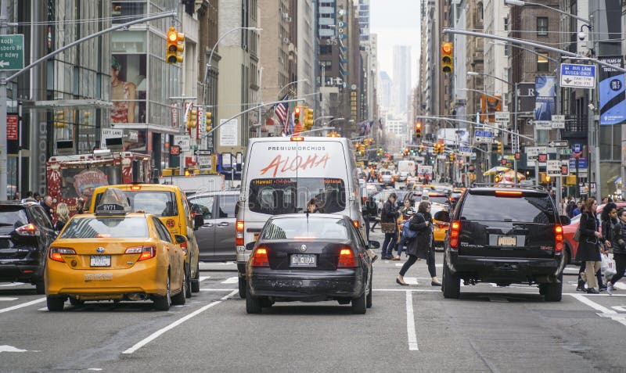
Deep Learning Project: Acoustic Scene Classification
Victor Barberteguy
December, 8th 2023

Slide 2

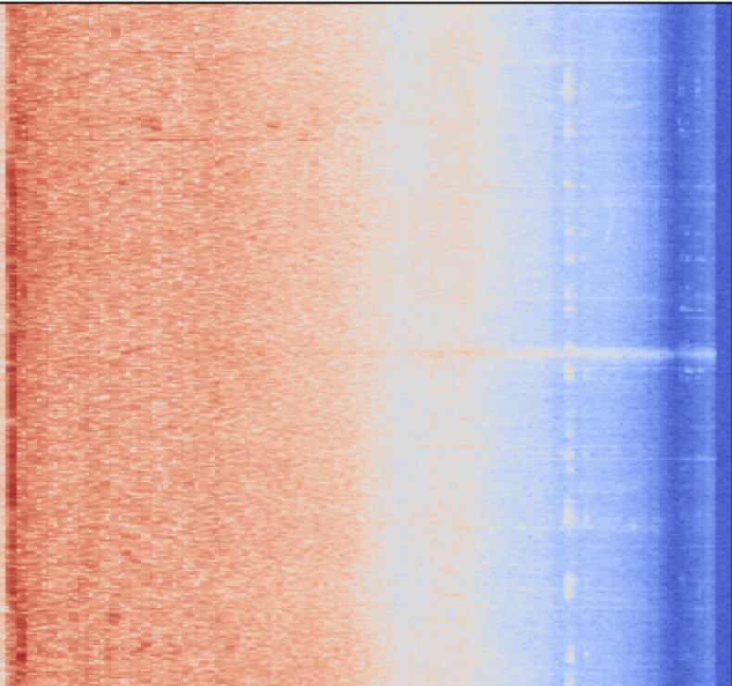
DCase 21 challenge
Task 1 – Acoustic scene classification
A – Low-complexity classification with multiple devices (<128kB)
Audio-Visual Scene Classification
Dataset: TAU Urban Acoustic Scene 2020 mobile truncated
10 classes: urban places
8000 audio recordings
Sampling 44,1KHz
FFT
MeL BINS
Log
LogMel Spectrogram
Task B : Anomaly detection
Task C: detection with directional interference
Task D: domestic environments
Task E: bioacoustic
Task F: audio Captioning
Aim of the presentation:
Don’t repeat what is in the report
Rather explain more in depth the technical concepts
Understand the results and limitations

Slide 3
CNN-based solution: SP4ASC
Proposed by Puy et al. for Dcase 21 challenge
Based on CNN6 model
Separable Convolution
Batch Normalization Merging
Test Time Augmentation
Reached 68.7% accuracy (first place of the challenge: Byeonggeun et al.: 76.1%)

Slide 4
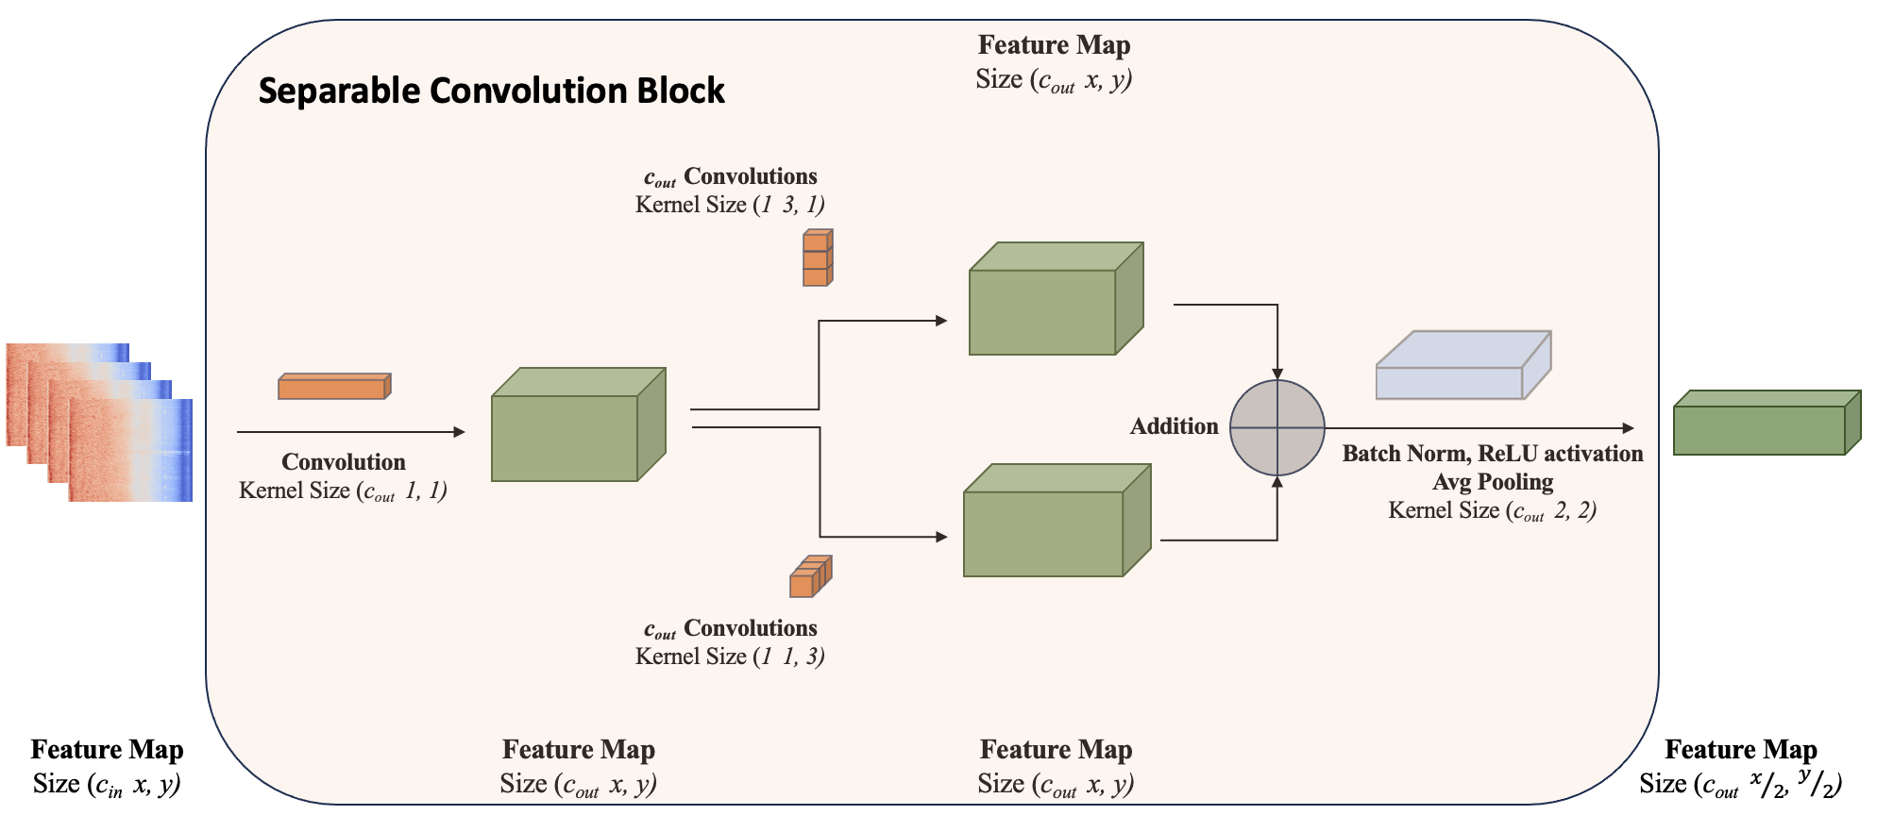

Slide 5
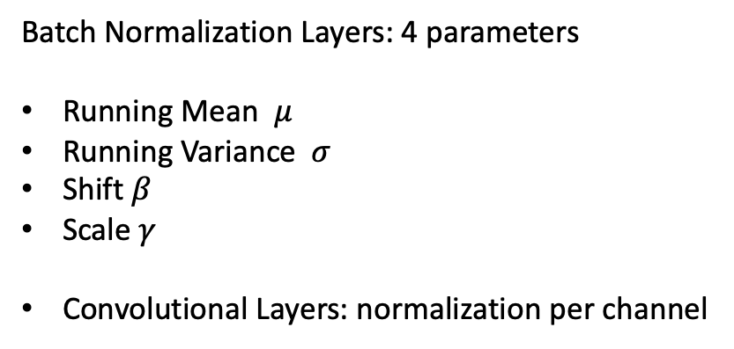
Batch Normalization Merging
Theoretically
Merge the normalization layer with the convolutional layer
Add a bias to the convolutional layer
Practically
Multiply weights by $\frac{γ}{σ}$
Multiply weights by 𝛾/𝜎
Impact
Less 2k parameters
Approximately same computing time on test and validation set
Add one bias $β − \frac{γ}{σμ}$ per channel
Add one bias 𝛽 − 𝛾/𝜎𝜇 per channel
« self.bn_layer = nn.Identity »
Batch Normalization Layers: 4 parameters
Running Mean $μ$
Running Variance $σ$
Shift $β$
Scale $γ$
Convolutional Layers: normalization per channel

Slide 6
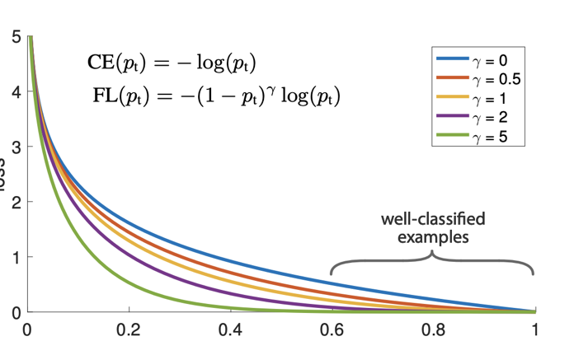
Test-Time Augmentation, Mix-Up and focal loss
TTA: Drop some frequencies or some timesteps from the LMS at test time, and add to the test dataset
Mixup: generates a weighted combination of random data from the batch
Focal Loss: mitigates overconfidence and class imbalance
Theoretically, Focal Loss minimizes athe regularized KL divergence
From Mukhoti et al., 2020

Slide 7
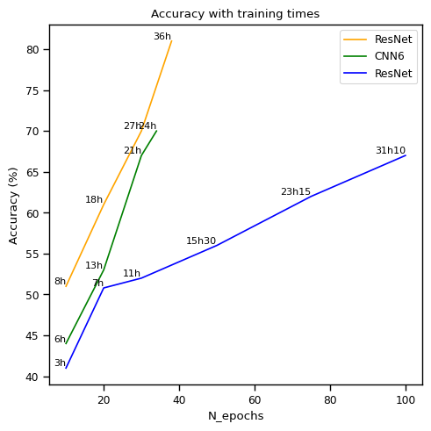
Less parameters… less good results
Less Training Time
Do not reach high accuracies: Why ?
Differences between the two types of convolution

Slide 8
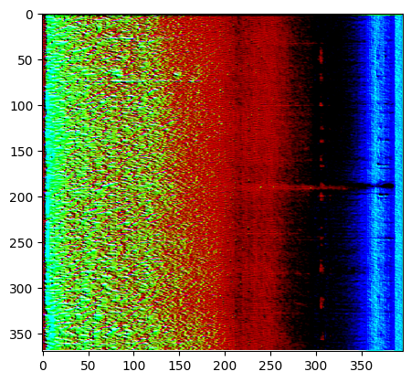
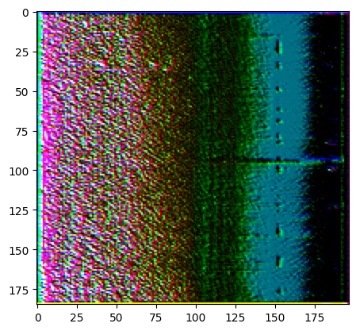
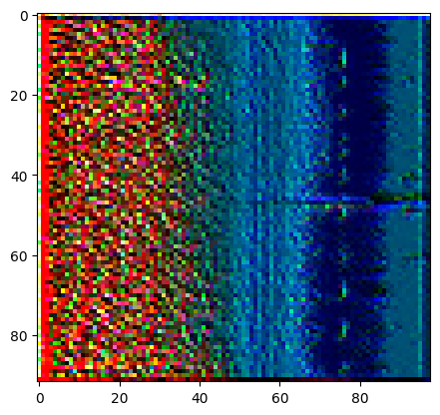
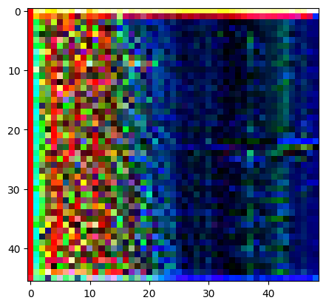
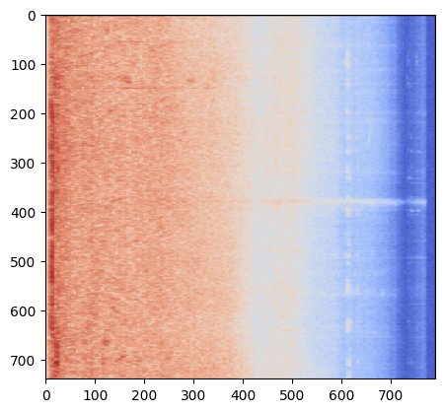
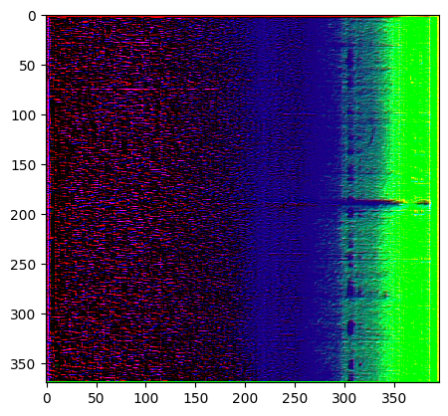
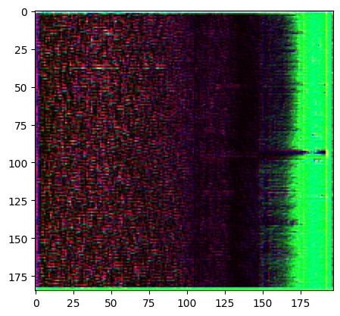
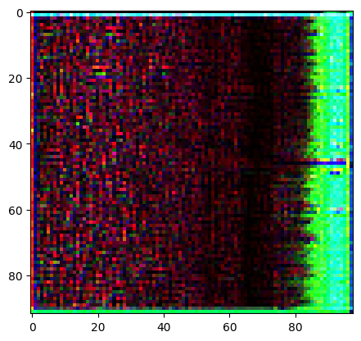
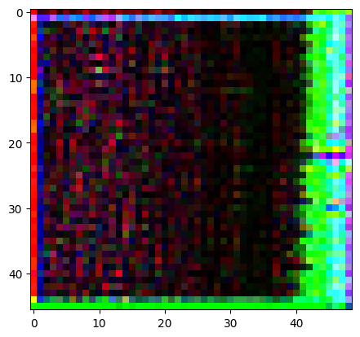
Classical and Separable convolutions
Classic conv.
Sep conv.

Slide 9
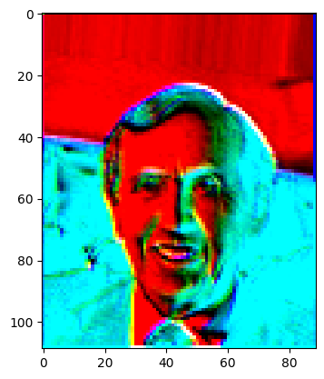
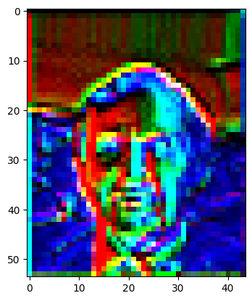
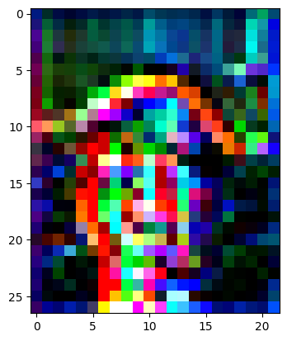
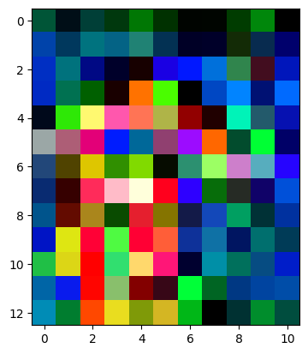
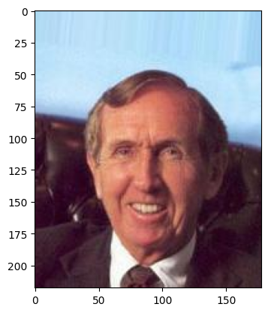
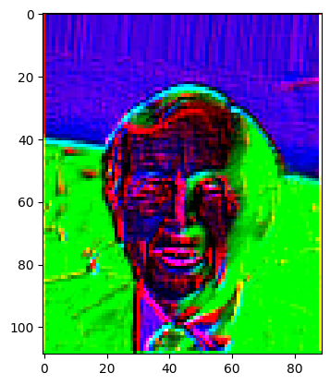
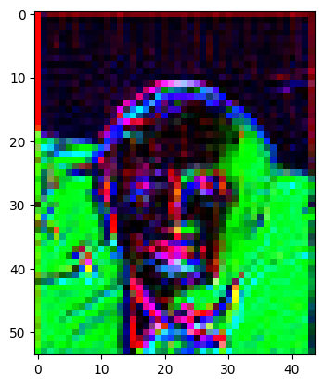
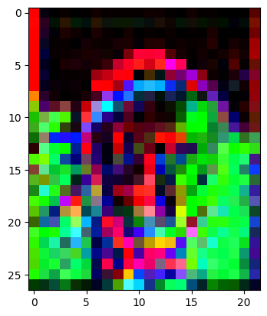
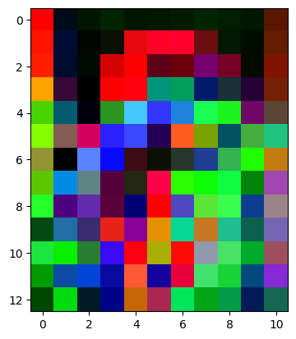
Classic conv.
Sep conv.

Slide 10
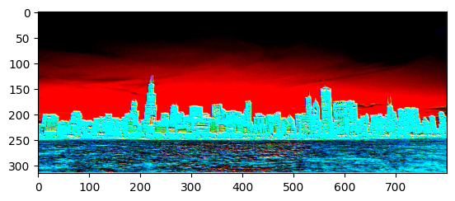
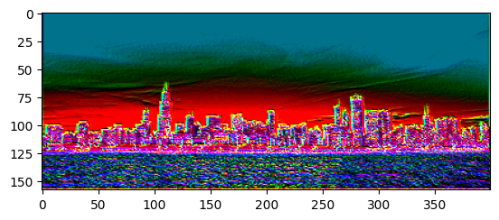
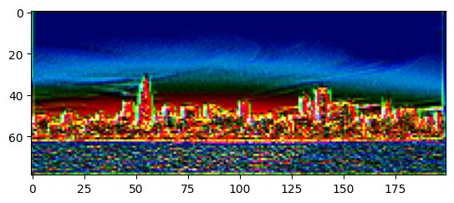
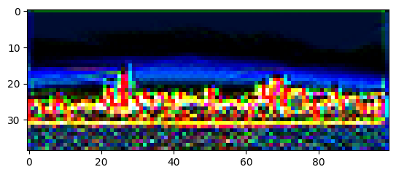
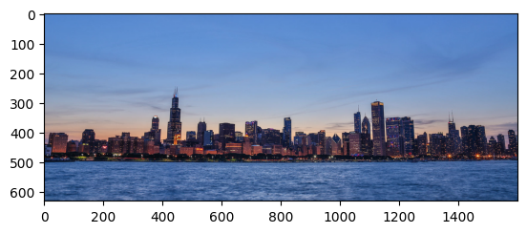
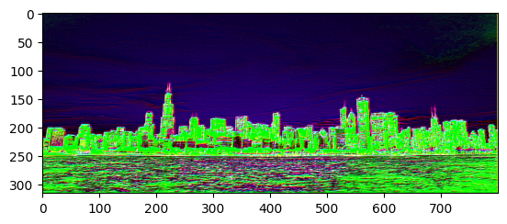
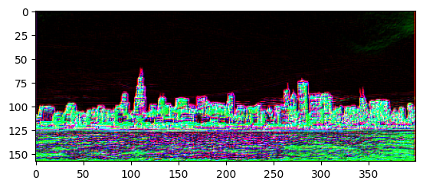
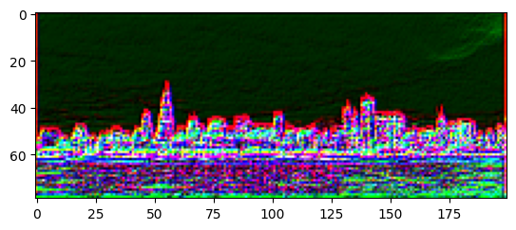
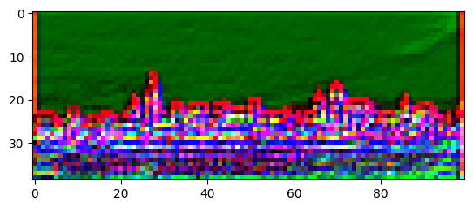
Classic conv.
Sep conv.
Classic Convolution: captures more efficiently the details, and especially the dependencies along axis
Separable convolution can forget dependencies if the values do not change

Slide 11
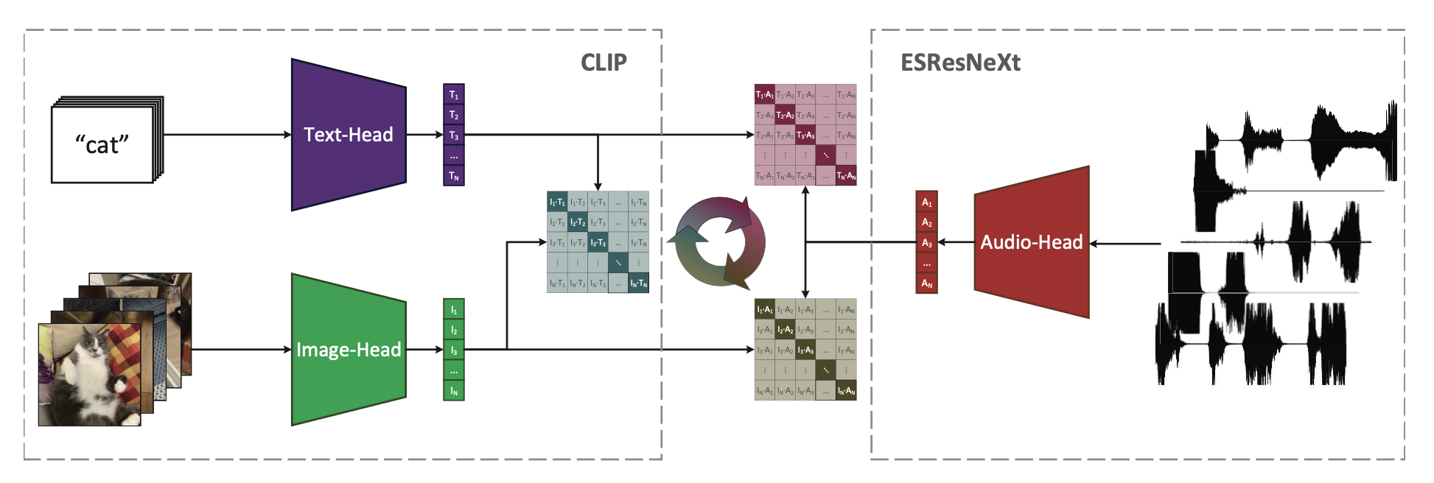
AudioCLIP model
Image from Guzhov et al. 2021
400M text-image pairs 1.8M audio recordings
Pre-Training ESResNeXt standalone
Pre-training ESResNeXt plugged to CLIP (image and text heads frozen): compatibility
Training of the whole model to take into account spatial distribution of other heads
Fine-Tuning of the AudioHead: standalone and then cooperative

Slide 12
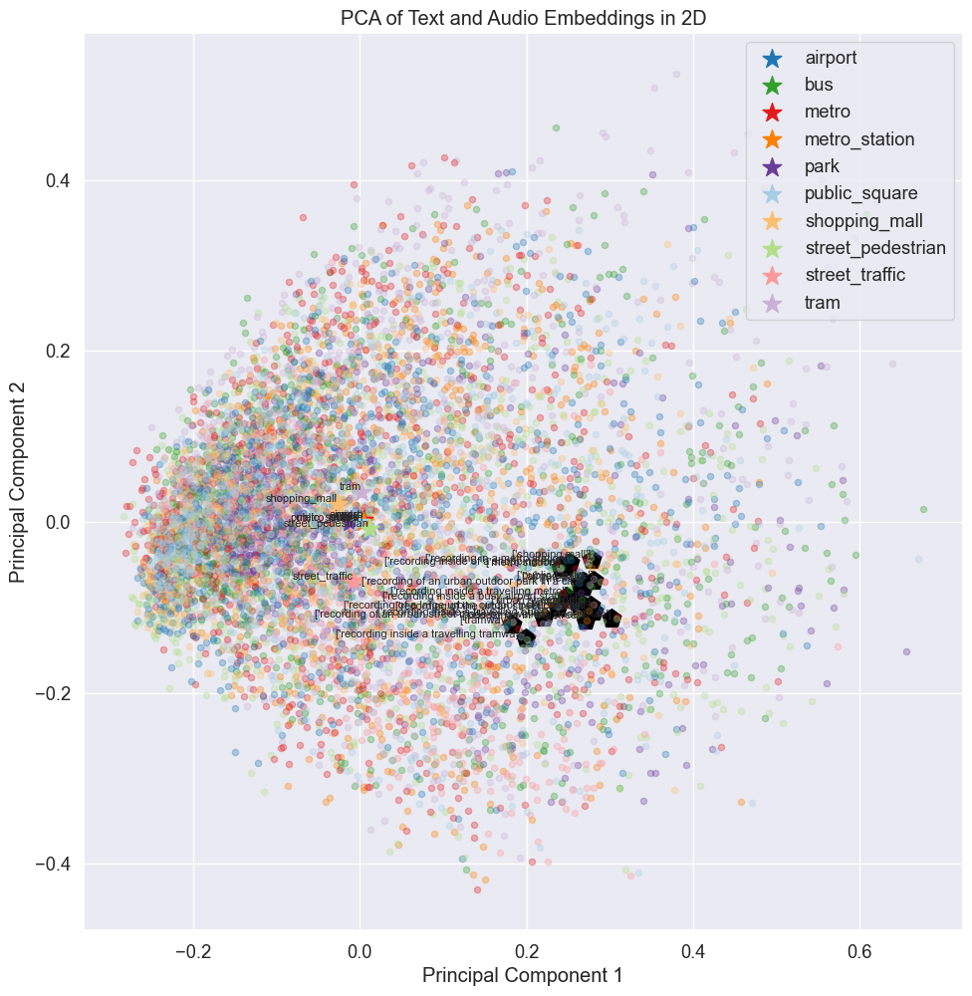
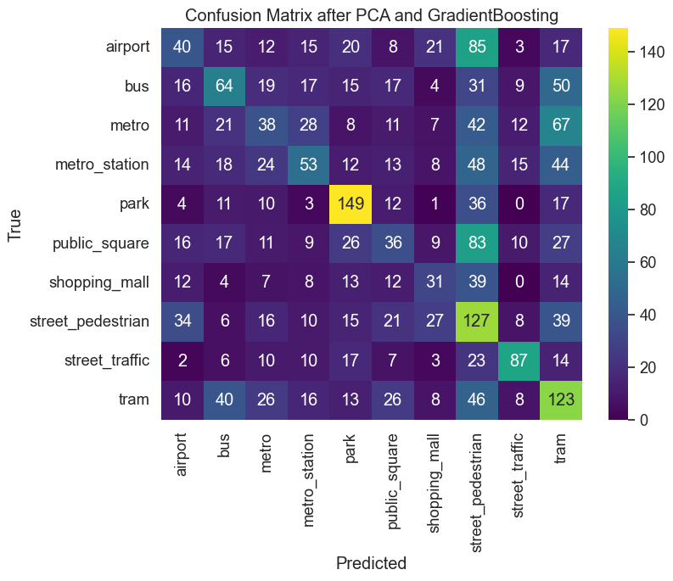
Accuracy: 0.38% after gradient boosting
Potential Cause:
Audio Head PreTraining (unbalanced dataset, ESResNeXt)
Covariate Shift with our dataset

Slide 13
Wrap-up
Investigated audio classification models, challenges with audio data
Classical CNNs and possible enhancements: ResNet, CNN6, CNN60k
Accuracy vs. Complexity
Rise of foundation models like AudioCLIP: needs good engineering
Delve deeper into the motivations and effects of design choices
Training models is time - and energy - consuming

Slide 14
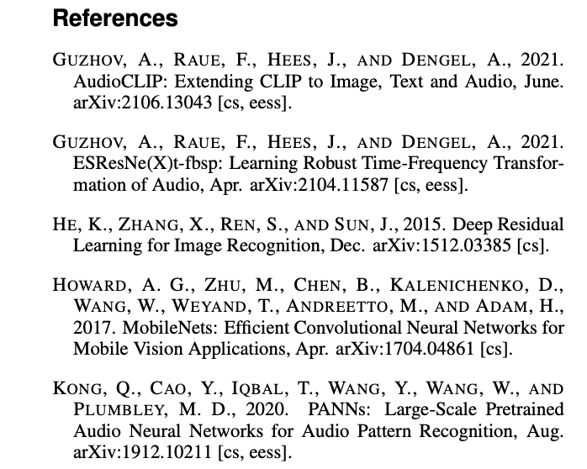
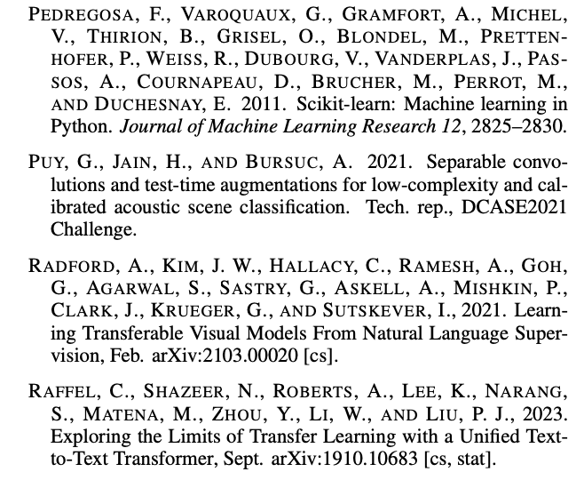
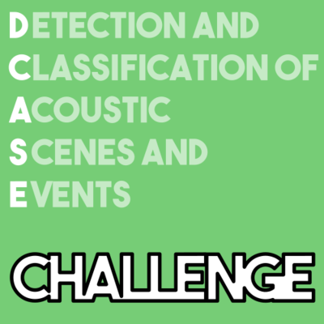
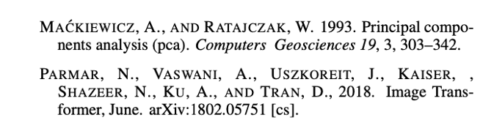
Code available at: https://github.com/VictorBbt/Acoustic_Scene_Classification

